Slide 1
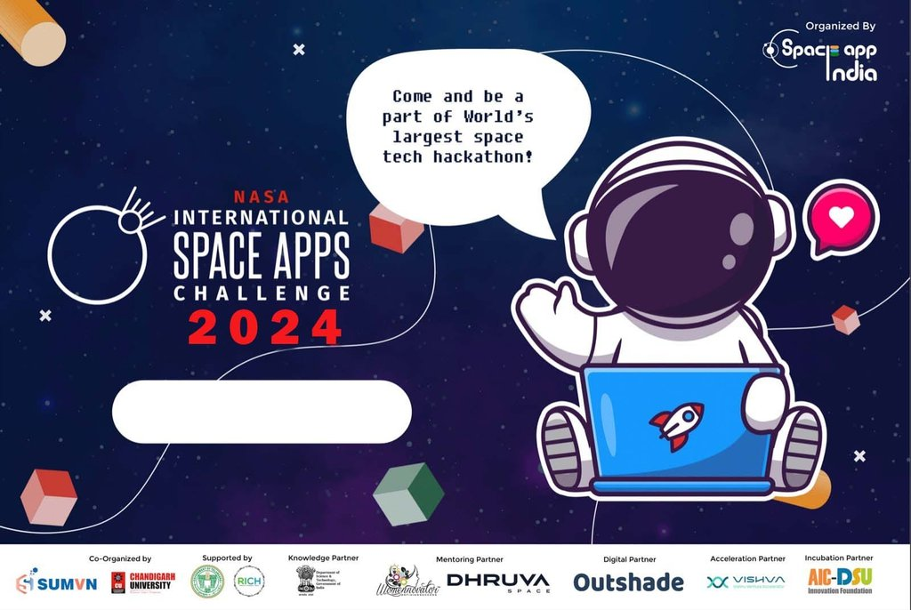

PRASUNETECH

Slide 2
NASA Space Apps 2024
Presented by: PRASUNETECH, MOHALI
PRAMOD PRAJAPAT
ARYAN SHARMA
ABHISHEK RAJ
Notes:
The world is facing many big challenges like climate change, water insecurity, and diseases; addressing these challenges in innovative ways requires interdisciplinary research using data from multiple sources. Many U.S. government agencies have substantial archives of high-quality, freely available data, but these archives can be difficult to navigate.

Slide 3
NASA Space Apps 2024
Challenge: Leveraging Earth Observation Data for Informed Agricultural Decision-Making.
Farmers face a deluge of water-related challenges due to unpredictable weather, pests, and diseases. These factors can significantly impact crop health, farmers’ profits, and food security. Depending upon the geography, many farmers may face droughts or floods—sometimes both of these extreme events occur within the same season! Your challenge is to design a tool that empowers farmers to easily explore, analyze, and utilize NASA datasets to address these water-related concerns and improve their farming practices.
Notes:
The world is facing many big challenges like climate change, water insecurity, and diseases; addressing these challenges in innovative ways requires interdisciplinary research using data from multiple sources. Many U.S. government agencies have substantial archives of high-quality, freely available data, but these archives can be difficult to navigate.

Slide 4
Climate change has had a great impact on agricultural yield around the world! How can we better understand and engage with agricultural data better?
By building a platform that enables people to better understand and access data, this will democratize access to various NASA datasets!

Slide 5





Web Architecture
Data Pipeline:
We have create our frontend with reach.js and Node.js ,Express.js for backend of our website.
Once the dataset is stored on mongoDB, we can use Tableau and a web application to pull the data for visualizations.

Slide 6

Our Solution:
Our project addresses the challenge of connecting the agricultural community with NASA's satellite and geospatial datasets to improve decision-making around Agriculture process. By creating an interactive web-based dashboard, farmers can access real-time data to optimize water usage, manage crops, and enhance resource efficiency.

Slide 7
Challenges:
The project encountered several key challenges, including simplifying complex NASA datasets into an easy-to-use interface for farmers, ensuring accurate real-time data integration, and designing a responsive dashboard that works across devices. Customizing the water usage calculator to suit diverse farm types, and making the tool accessible for non-technical users, added to the complexity. Additionally, addressing potential issues with limited internet connectivity in rural areas was a critical technical hurdle. Overcoming these challenges was essential to ensure the tool's practicality and usefulness for the agricultural community.

Slide 8
Data Sources
Four data sources, from US Department of Agriculture (USDA) and NASA, were chosen to tell our story.
NASA EarthData Search
USDA AG Data Commons
USDA Economic Research Service
A Global Dataset of Soil Respiration, v5.0
CPI Forecast
Feed Grains
Food Prices (2020)

Slide 9
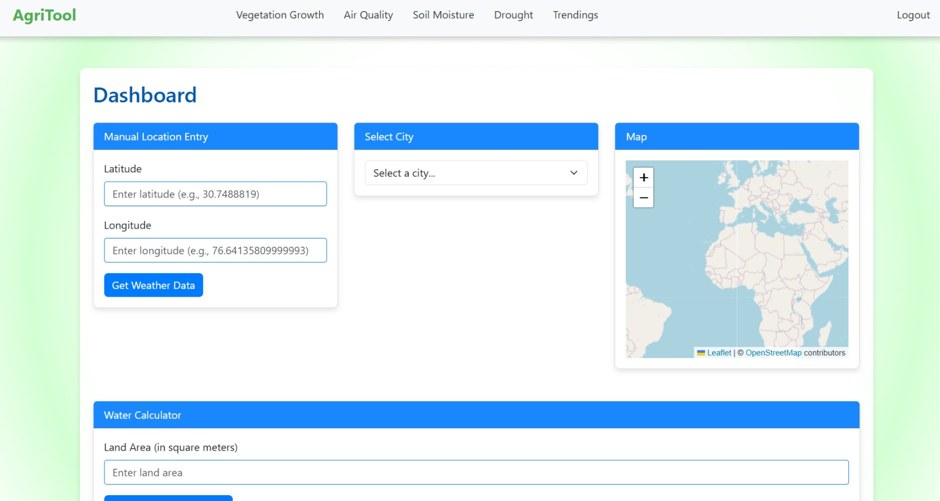
Web Dashboard(UI)

Slide 10
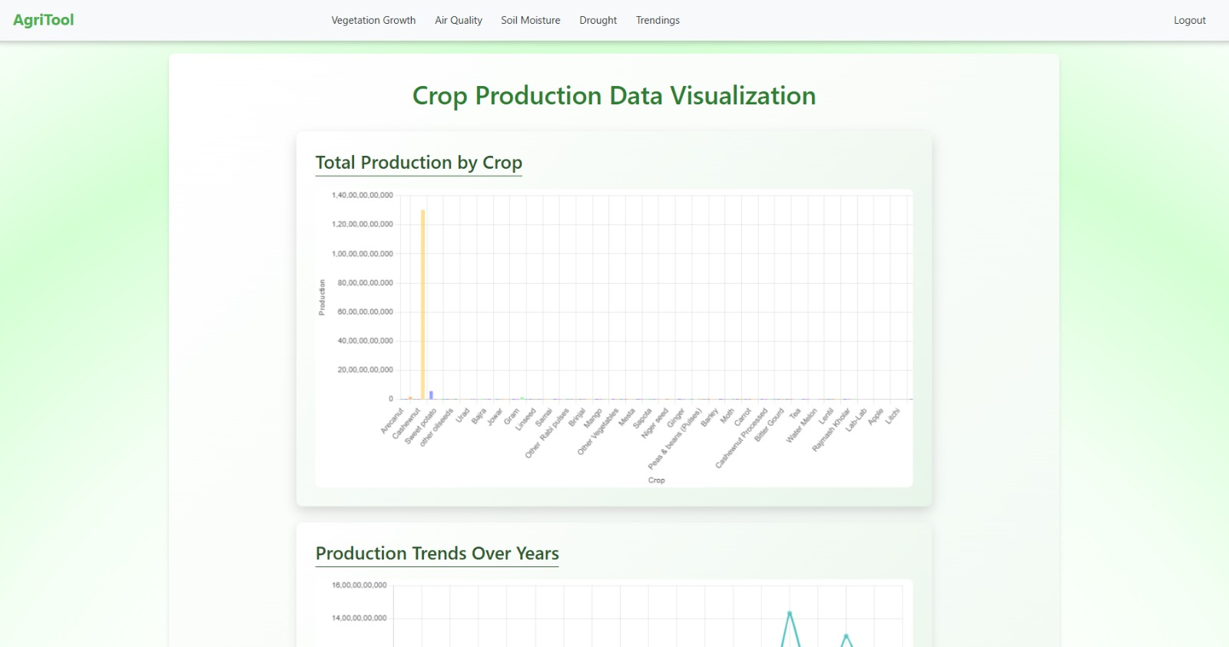
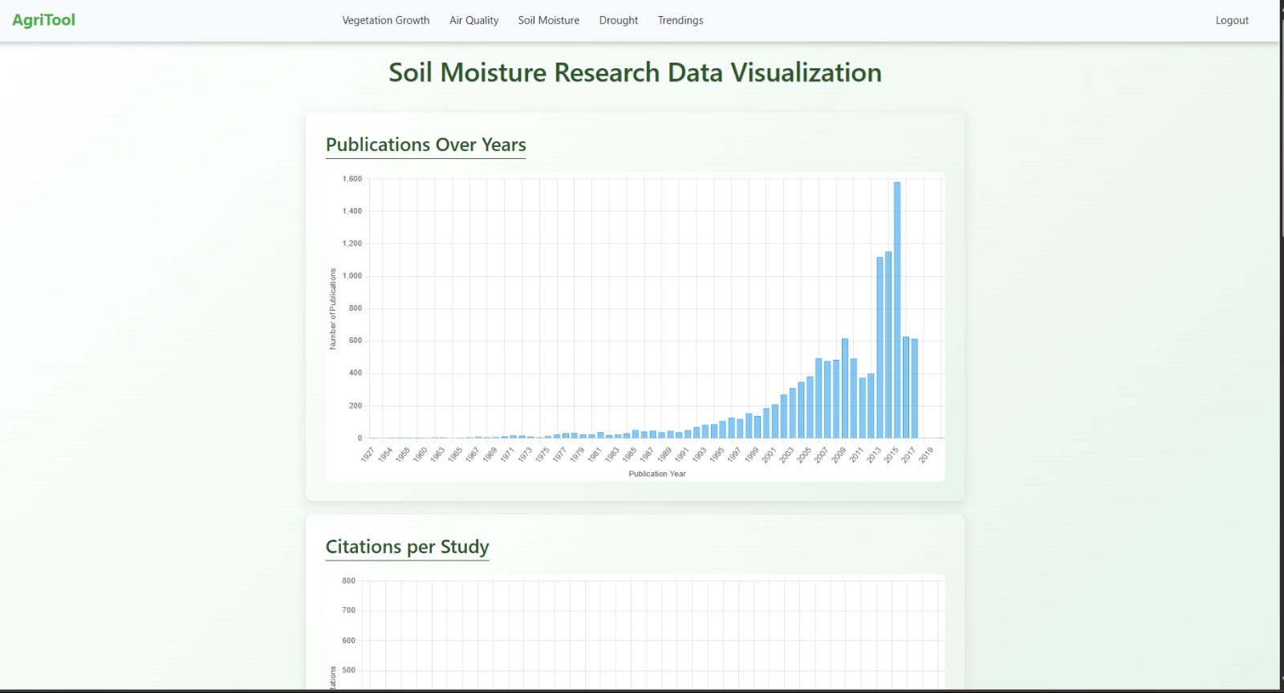
Outcome(UI):

Slide 11
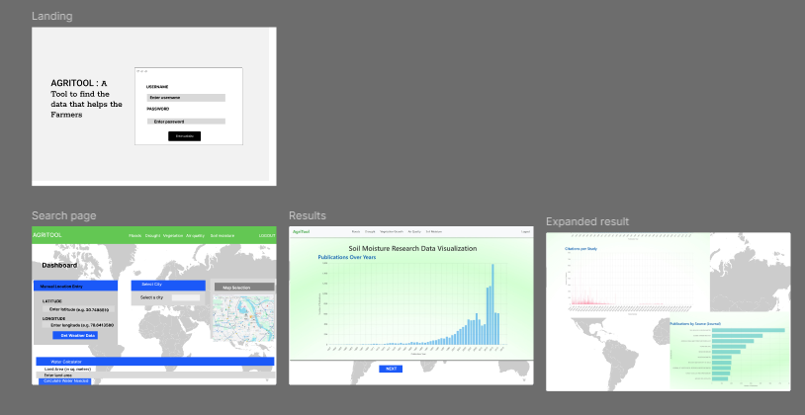
Wireframe + Web Application
Our prototype was first drafted from typical data interfaces. We used a proto-customer journey to apply design thinking processes and find where we could improve. Feedback was drawn from all team members, not just designers, for fresh eyes and input.
Click here to view our live prototype
Click here to view our Demo Video

Slide 12

Thank You!
Contact details:
Abhishek Raj
Email-workwithabhishek2@gmail.com
Aryan Sharma
Email-sharmaaryan732100@gmail.com
Pramod Prajapat
Email-prajapatpramod474@gmail.com

